Slide 1

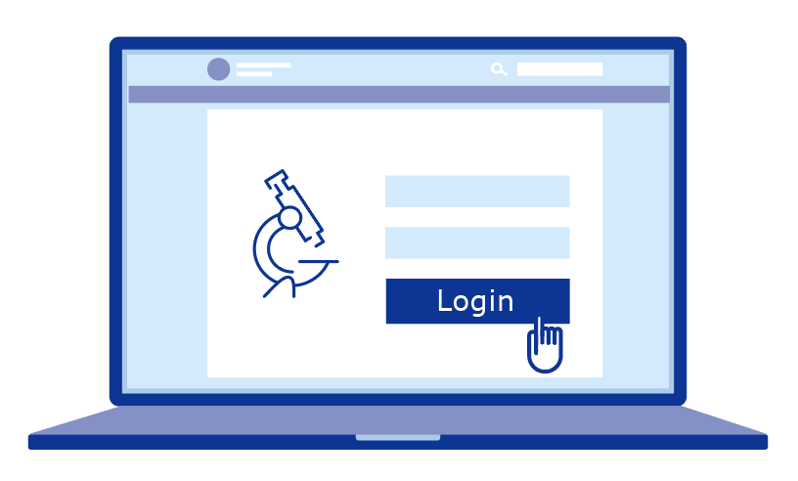

CTIS will be the single entry point for submitting clinical trial information in the EU and the European Economic Area (EEA). CTIS contains:
A public website where anyone can search for information on clinical trials
A Sponsor workspace where clinical trial sponsors and the organisations that work with them can apply for and manage a clinical trial in up to 30 EU/EEA countries
An Authority workspace for EU Member States, EEA countries and the European Commission to assess, authorise and oversee clinical trials
Open access
Secure access

Slide 2
The Clinical Trials Regulation foresees a 3-year transition period to CTIS:
Transition year 1
Transition years 2 and 3
31 Jan 2022
31 Jan 2023
31 Jan 2025
Clinical Trials Regulation enters into application and CTIS goes live
All initial clinical trial applications must be submitted through CTIS
All ongoing clinical trials must be transferred to CTIS

Slide 3
How clinical trials are processed in CTIS
Clinical trial sponsors who want to gain approval to run a clinical trial in one or more EU/EEA countries submit a single clinical trial application form and supporting dossier through CTIS.
The submission of the single clinical trial application includes the public registration of the trial.
National regulators of EU/EEA Member States assess the clinical trial application. If they authorise the application, the trial can begin.
CTIS supports the day-to-day business processes of EU Member States, EEA countries and sponsors throughout the lifecycle of a clinical trial. It will provide regulatory oversight of trials and tools for supervision and monitoring.

Slide 4
How to prepare for CTIS
Sponsors can consult the CTIS Sponsor Handbook for guidance on how to prepare for CTIS.
The CTIS online training programme is another key resource.
The guide to the CTIS training material catalogue on the CTIS training programme page provides an overview of the training catalogue.

Slide 5
How to register for CTIS
Ensure you have an EMA account
  You already have an EMA account if you use EMA systems like Eudravigilance or the substances, products, organisations and referentials database (SPOR)
  If you do not already have an account, register via EMA Account Management
Choose your user management approach (organisation vs trial centric)
  Organisation-centric allows for the management of users by an administrator at the organisation level rather than at the level of an individual trial. It is intended for organisations that will run several trials in CTIS
For the organisation-centric approach, ensure your organisation is registered in OMS and register your first High-Level Administrator via EMA Account Management
Ensure your product is registered in XEVMPD
View the ‘Getting started with CTIS quick guide’ here.

Slide 6
Useful links
Information on CTIS: https://www.ema.europa.eu/en/human-regulatory/research-development/clinical-trials/clinical-trials-regulation
CTIS training and support: https://www.ema.europa.eu/en/human-regulatory/research-development/clinical-trials/clinical-trials-information-system-training-support
Online modular training on CTIS functionalities: https://www.ema.europa.eu/en/human-regulatory/research-development/clinical-trials/clinical-trials-information-system-ctis-online-modular-training-programme
CTIS Sponsor Handbook: https://www.ema.europa.eu/en/human-regulatory/research-development/clinical-trials/clinical-trials-information-system-training-support#handbook-for-clinical-trial-sponsors-section
CTIS Newsletter: https://www.ema.europa.eu/en/news-events/publications/newsletters#clinical-trials-information-system-(ctis)-highlights-section
For information on the Clinical Trials Regulation: EudraLex - Volume 10 - Clinical trials guidelines | Public Health (europa.eu) and Draft - Questions and Answers Document - Regulation (EU) 536/2014 – Version 4.1 (September 2021)

